Slide 1
Operating
System Architectures
Supervised by Brainwave Data Co, Ltd.
Presented by
Nay Myo Aung

Slide 2
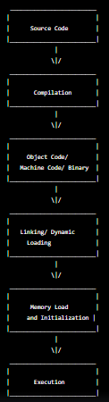

From High Level Code ( C, C++, Java ) To Store in Memory :
Compilation :
High-level code -> Compiler -> Machine code (Binary format)
Object file generation :
Machine code + Object file information -> Object file (.o)
Linking :
Object file + Libraries -> Executable file (.exe)
Memory allocation :
Memory -> Code section, Data section, Stack, Heap, Static Data
Storing code in memory :
Code section of memory -> Machine code
Storing data in memory:
Data section of memory -> Variables, Constants, Arrays
Performance, Portability, Debugging, Development speed, Security
High-level Code --> Interpreter --> Memory Storage --> Machine Code

Slide 3
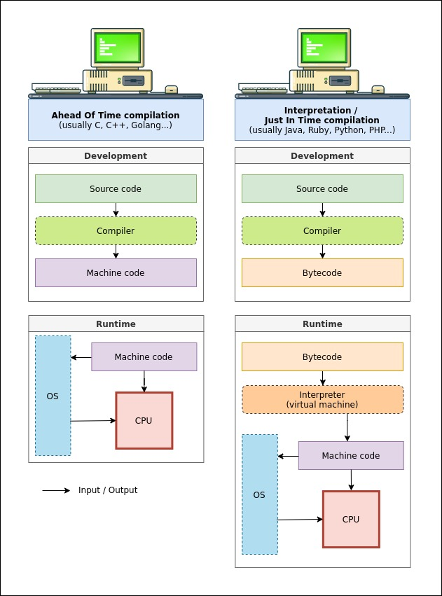
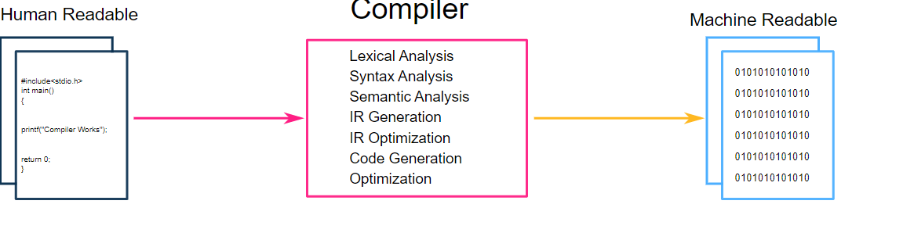

Slide 4
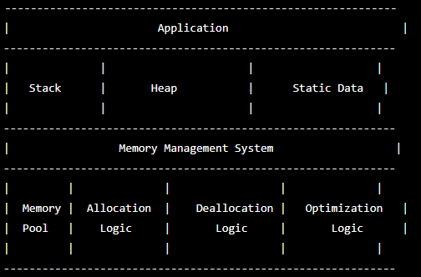
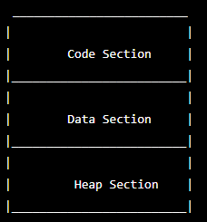
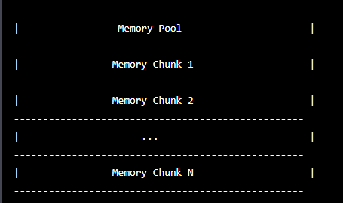
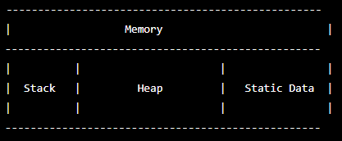

Slide 5
Operating System Definition :
A collection of software programs that manages computer hardware resources and provides common services for computer programs and an intermediary between applications and computer hardware.
Importance of OS for Developers :
1. Hardware Abstraction
2. Memory Management
3. Process Management
4. Security
5. User Interface
6. Platform Independence
7. Application Compatibility, etc.

Slide 6
Skills to build an Operating System :
1. Proficiency in programming languages
2. Knowledge of computer architecture
3. Understanding of operating system concepts
4. Knowledge of system-level programming
5. Debugging skills
6. Testing skills
7. Documentation skills
8. Collaboration and teamwork skills
9. Project management skills
10. Familiarity with operating system development tools, etc.

Slide 7
OS Architecture :
Kernel : the central component of an operating system. It is a program that manages the system's hardware and software resources and provides services to applications and a bridge between the applications and the computer's hardware.
low-level services to higher-level software :
Memory management: The kernel manages the system's memory, allocating and deallocating memory for processes as needed. This is a low-level service that is critical for the efficient use of system resources.
Web browser: A web browser is an application that runs on top of the operating system and provides a user interface for accessing and interacting with websites. The browser relies on low-level services provided by the kernel, such as network communication and file system access, to function.

Slide 8
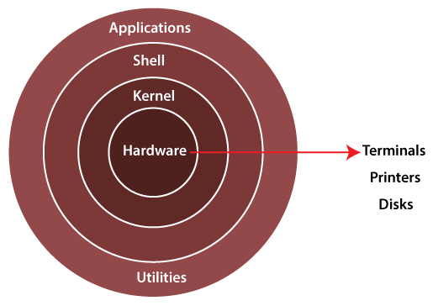
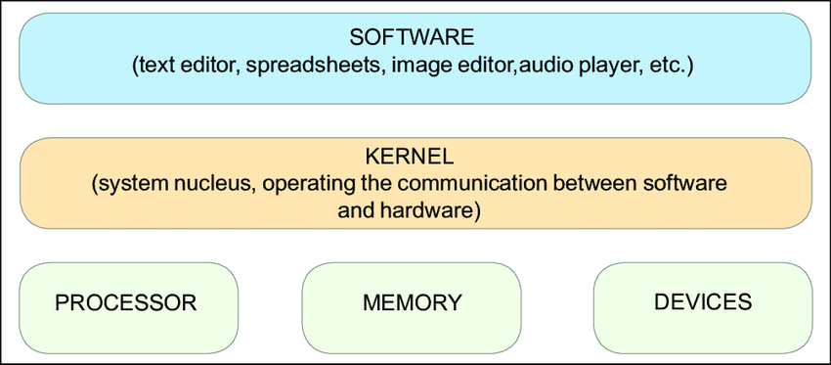
Monolithic Kernel :
Microkernel :
Hybrid Kernel :
Exokernel :
Nanokernel :
Linux OS :
Window OS :
MacOS :
Android OS :
IOS :
QNX :
Window NT : 1993

Slide 9
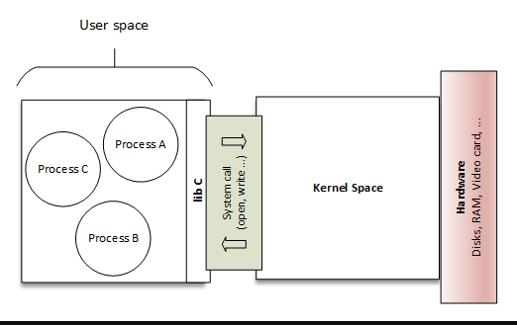

Slide 10
User Space : accessible to user-level programs and applications and libraries, utilities, and applications that are installed on the operating system.
System Call : user-level applications to request services from the kernel and to interact with the operating system while maintaining security and stability.
Driver : communication between the operating system and a hardware device and allows the operating system to interact with hardware devices, such as printers, graphics cards, and network adapters.

Slide 11
Thank You
Any Question ?

